Slide 1

End-to-End Supply Chain Data Architecture and Analytical Framework
A comprehensive technical deep-dive into enterprise-grade ETL pipeline development and advanced SQL analytics for supply chain optimization

Slide 2
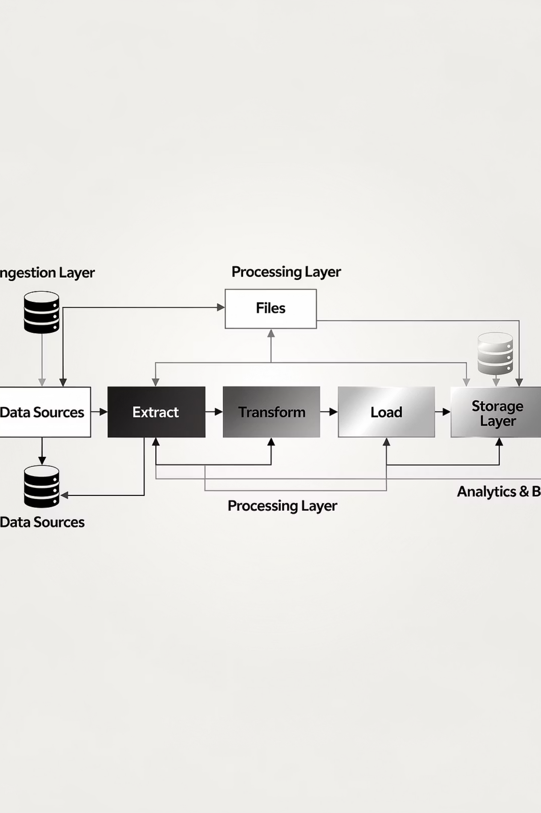
OVERVIEW
Executive Overview: Two-Phase Architecture
Phase I: Data Engineering
Phase II: Strategic Analytics
Python-based ETL pipeline transforming raw legacy CSV data into a normalized PostgreSQL database. Implements rigorous data quality protocols, feature engineering, and privacy-compliant data masking to establish a single source of truth for analytical workflows.
Comprehensive SQL analytical suite delivering multi-dimensional insights across logistics efficiency, financial performance, customer segmentation, and temporal trends. Advanced queries uncover actionable intelligence for data-driven decision making.

Slide 3
DATA ENGINEERING
Phase I: Python ETL Pipeline Architecture
The foundational data engineering layer processes the DC Supply Chain dataset through a sophisticated transformation workflow. Built using Pandas and SQLAlchemy, this pipeline ensures data integrity, consistency, and analytical readiness.
01
02
Data Ingestion
Standardization
Raw CSV ingestion using Pandas with latin-1 encoding to resolve character conflicts. Initial schema inspection validates structural integrity and identifies null distributions.
Nomenclature normalization to snake_case prevents SQL syntax errors. Semantic renaming clarifies ambiguous fields. High-cardinality and PII fields removed for optimization and compliance.
03
04
Quality Validation
Database Migration
Datetime parsing enables temporal arithmetic. Logic checks verify shipping record consistency. Feature engineering creates delay_variance metric for efficiency quantification.
SQLAlchemy connector establishes PostgreSQL interface. Replace strategy ensures analytical database reflects current pipeline state. Ready for downstream SQL analysis.

Slide 4

Data Cleaning and Standardization Protocol
1
2
3
Column Nomenclature
Semantic Mapping
Privacy Optimization
All headers converted to snake_case (lowercase with underscores) to prevent SQL syntax errors from spaces or mixed-case identifiers.
days_for_shipping_(real) → actual_shipping_days
Removed product_description, customer_email, customer_password, and customer_zipcode fields to optimize query performance and ensure GDPR compliance.
days_for_shipment_(scheduled) → scheduled_shipping_days
shipping_date_(dateorders) → shipping_date

Slide 5

FEATURE ENGINEERING
Data Integrity and Derived Metrics
Temporal Feature Engineering
Date fields (order_date, shipping_date) parsed to datetime objects enabling sophisticated temporal arithmetic and time-series analysis capabilities.
Logic Validation Framework
Implemented data quality checks comparing calculated shipping duration (shipping_date - order_date) against recorded actual_shipping_days to identify and flag inconsistencies in source data.
Performance Metric Generation
Created delay_variance derived metric by calculating the difference between actual_shipping_days and scheduled_shipping_days. This quantifies logistics efficiency and enables bottleneck identification across geographic and operational dimensions.

Slide 6
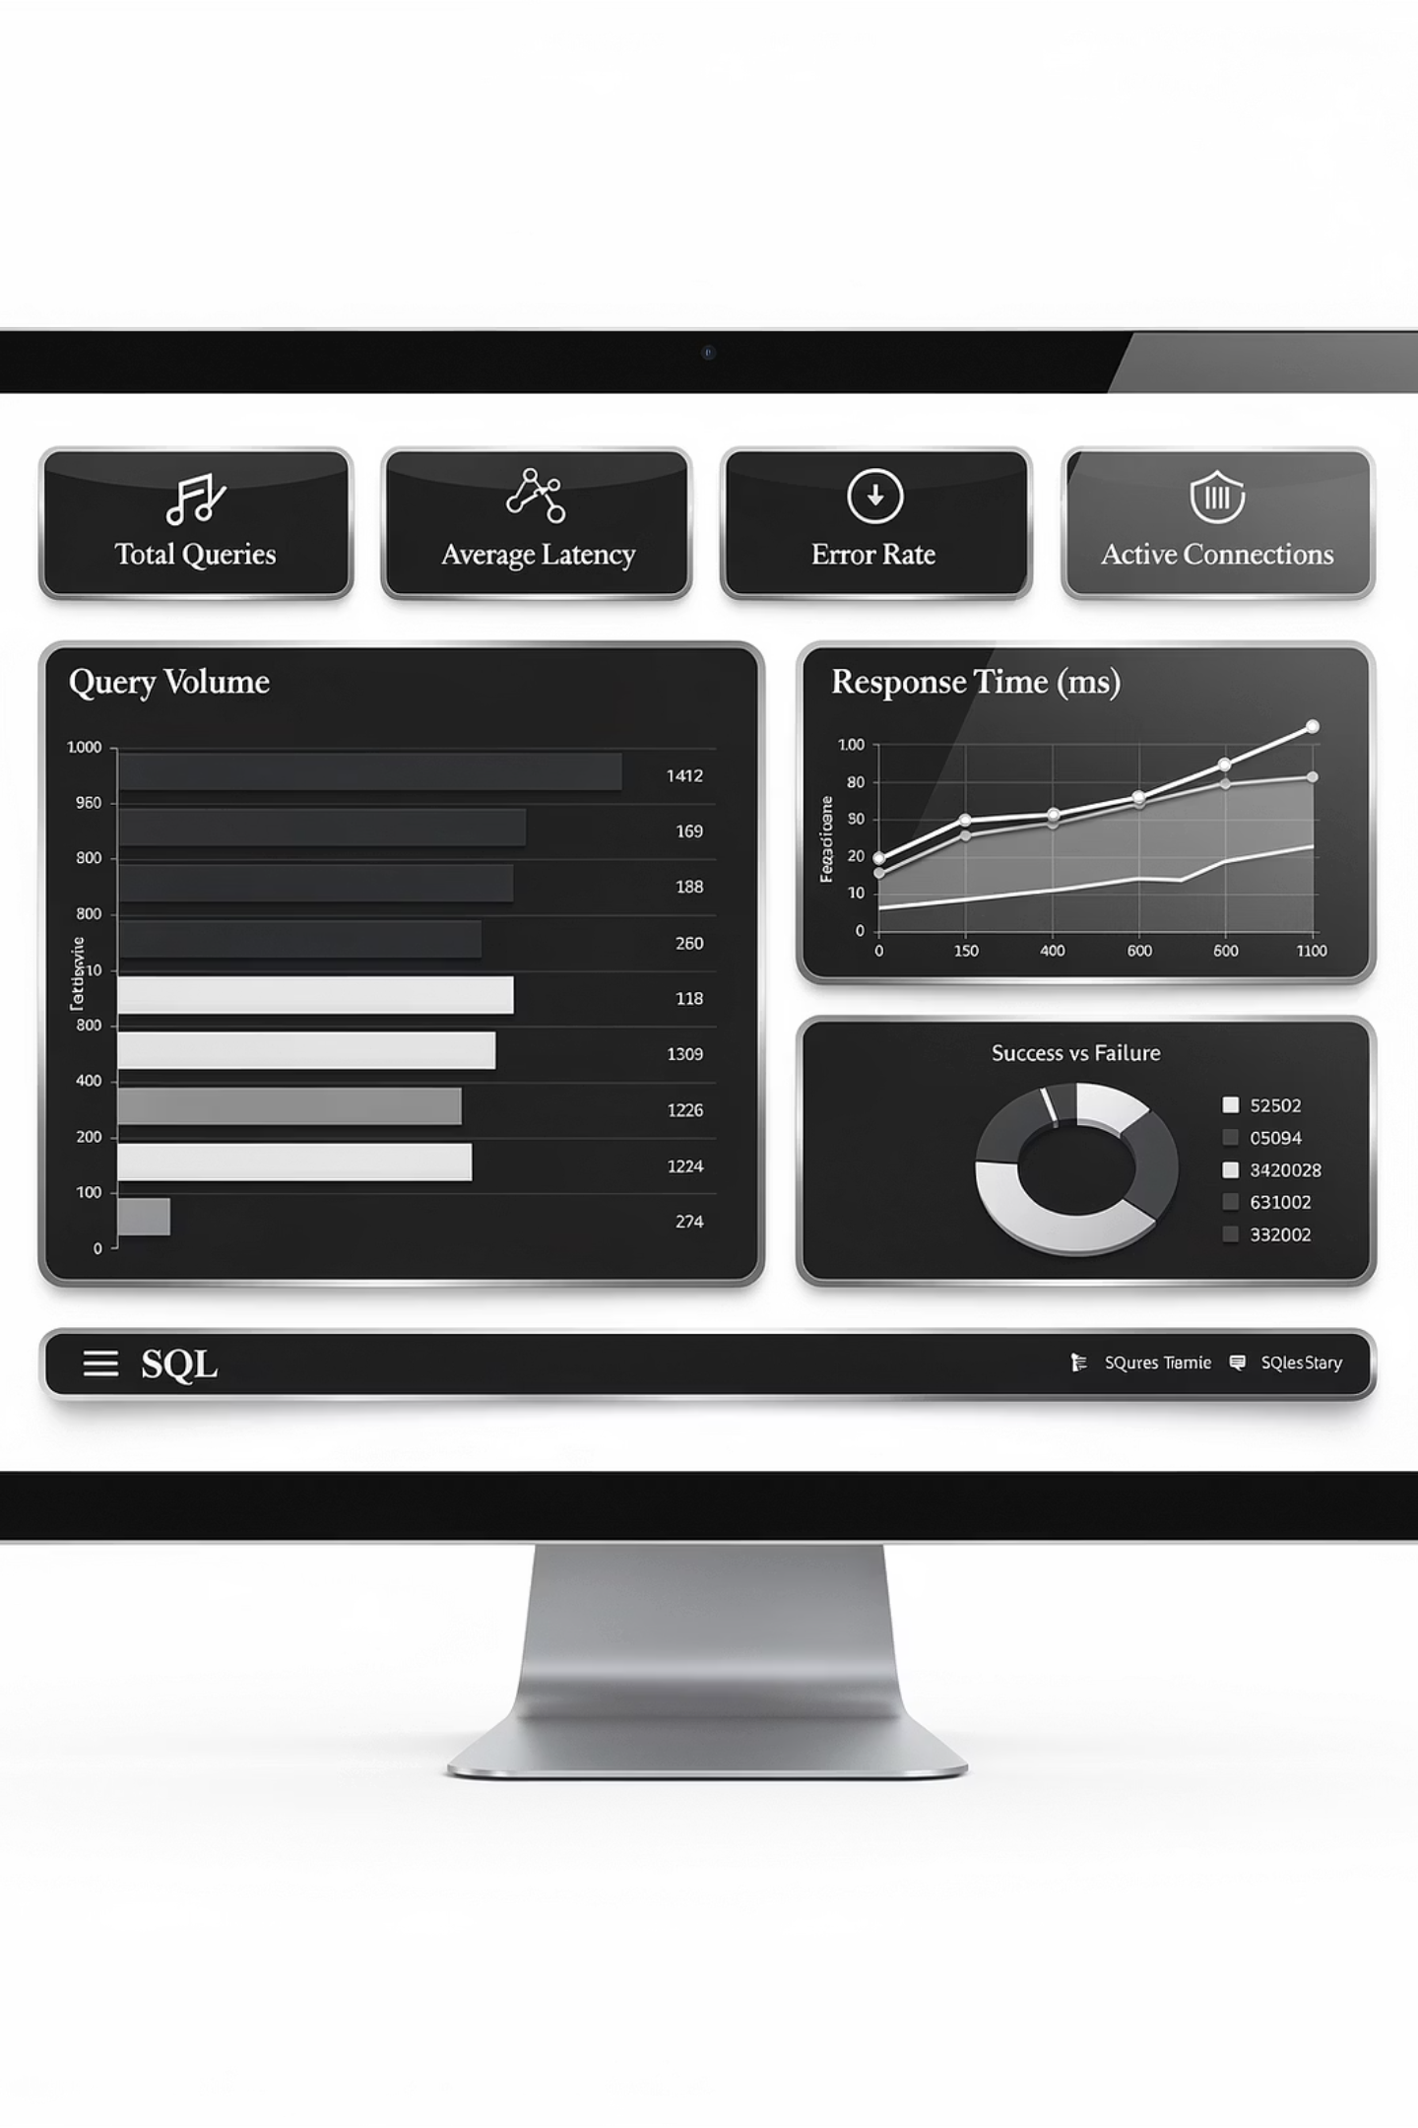
SQL ANALYTICS
Phase II: Strategic Data Analysis Framework
The analytical suite leverages advanced SQL techniques to extract actionable insights across four critical business dimensions. Each query is designed to answer specific strategic questions and inform operational decisions.
Logistics & Operations
Geographic bottleneck identification and shipment mode reliability analysis
Financial Health
Market profitability ranking and department revenue performance assessment
Customer Intelligence
Segment value analysis, CLV calculation, and fraud pattern detection
Temporal Dynamics
Time-series trend analysis with MoM/YoY growth and seasonality patterns

Slide 7
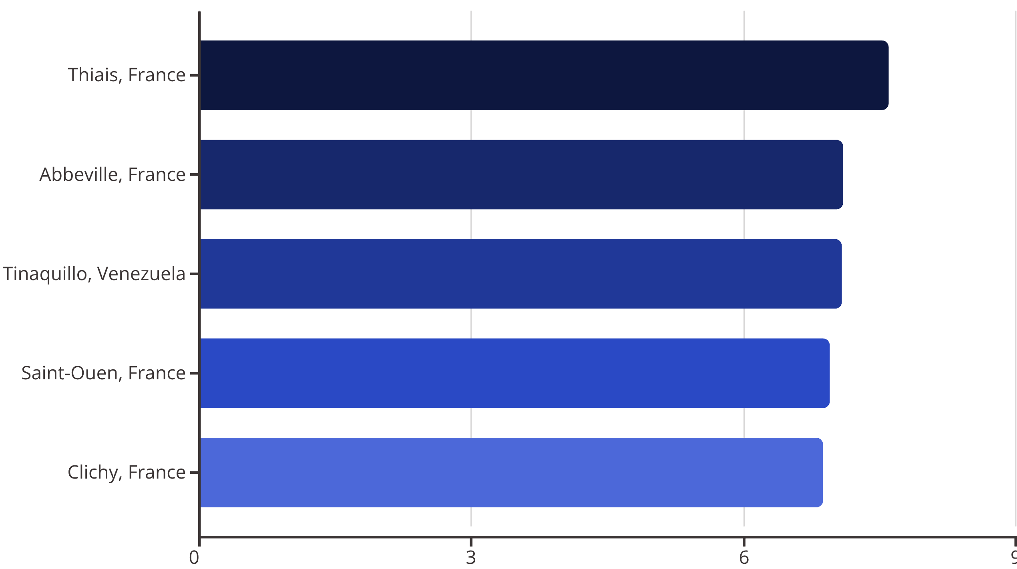

Critical Finding: Geographic Shipping Bottlenecks
Analysis of delay variance across global distribution nodes reveals significant unpredictability in specific locations. Thiais, France emerges as the most problematic logistics hub with extreme shipping variability.
France dominates the top 5 most unpredictable shipping locations, suggesting systemic logistics infrastructure challenges requiring immediate operational review and potential carrier relationship reassessment.

Slide 8



Shipment Mode Reliability Analysis
Comparative analysis of late delivery rates versus on-time performance reveals critical reliability gaps across shipment modes. First Class shipping presents the most significant operational risk.
95.3%
38.1%
50%
First Class Late Rate
Standard Class Late Rate
Same Day On-Time
Critically unreliable with near-total late delivery performance
Moderate reliability but still misses deadlines in over one-third of shipments
Most reliable option, though only achieving baseline 50% punctuality
These findings indicate urgent need for carrier performance reviews and potential contract renegotiations, particularly for First Class service level agreements.

Slide 9
FINANCIAL ANALYSIS
Market Profitability and Revenue Performance
Regional Profit Margins
Department Revenue Leaders
Geographic market analysis reveals USCA (US & Canada) leading profitability at 11.14%, with Africa (10.99%) and Latin America (10.93%) showing competitive margins. All major markets maintain healthy double-digit profitability.
Fan Shop dominates revenue generation at $17.1M, significantly outperforming other categories. Apparel follows at $7.9M, while Book Shop and Pet Shop underperform dramatically.
Fan Shop: $17.1M (Top performer)
11.14%
Apparel: $7.9M (Strong second)
Outdoor: $5.2M
USCA Market
Book Shop: $12.6K (Underperformer)
Pet Shop: $41.5K (Critical review needed)
10.99%
Africa Market
10.93%
LatAm Market

Slide 10

Loss Leader Identification: The Margin Challenge
High-volume categories with disproportionately low profit margins represent strategic risks. The Strength Training category demonstrates this phenomenon most severely, generating substantial sales but minimal profit contribution.
Strength Training
Margin: 0.60% - Major loss leader with critically thin profitability despite high sales volume. Immediate pricing strategy review recommended.
As Seen on TV
Margin: 3.47% - Significantly underperforming relative to operational costs. Consider category rationalization or supplier renegotiation.
Strategic Implications
These loss leaders require urgent attention: either optimize pricing/costs or evaluate strategic value of maintaining these product lines for customer acquisition purposes.

Slide 11

CUSTOMER ANALYTICS
Customer Segmentation and Lifetime Value
Segment Revenue Contribution
The Consumer segment drives the majority of revenue at $19.1M, representing the largest addressable market. Interestingly, Average Order Value (AOV) remains remarkably consistent across all segments at approximately $204, suggesting price sensitivity is uniform regardless of customer type.
$19.1M
$204
Consumer Revenue
Consistent AOV
Across all segments
Top 1% Customer Value
207 customers comprise the elite tier with spending exceeding $6,471. The highest-value customer (ID 791) has contributed $10,524 lifetime value, representing critical retention targets for personalized engagement programs.

Slide 12
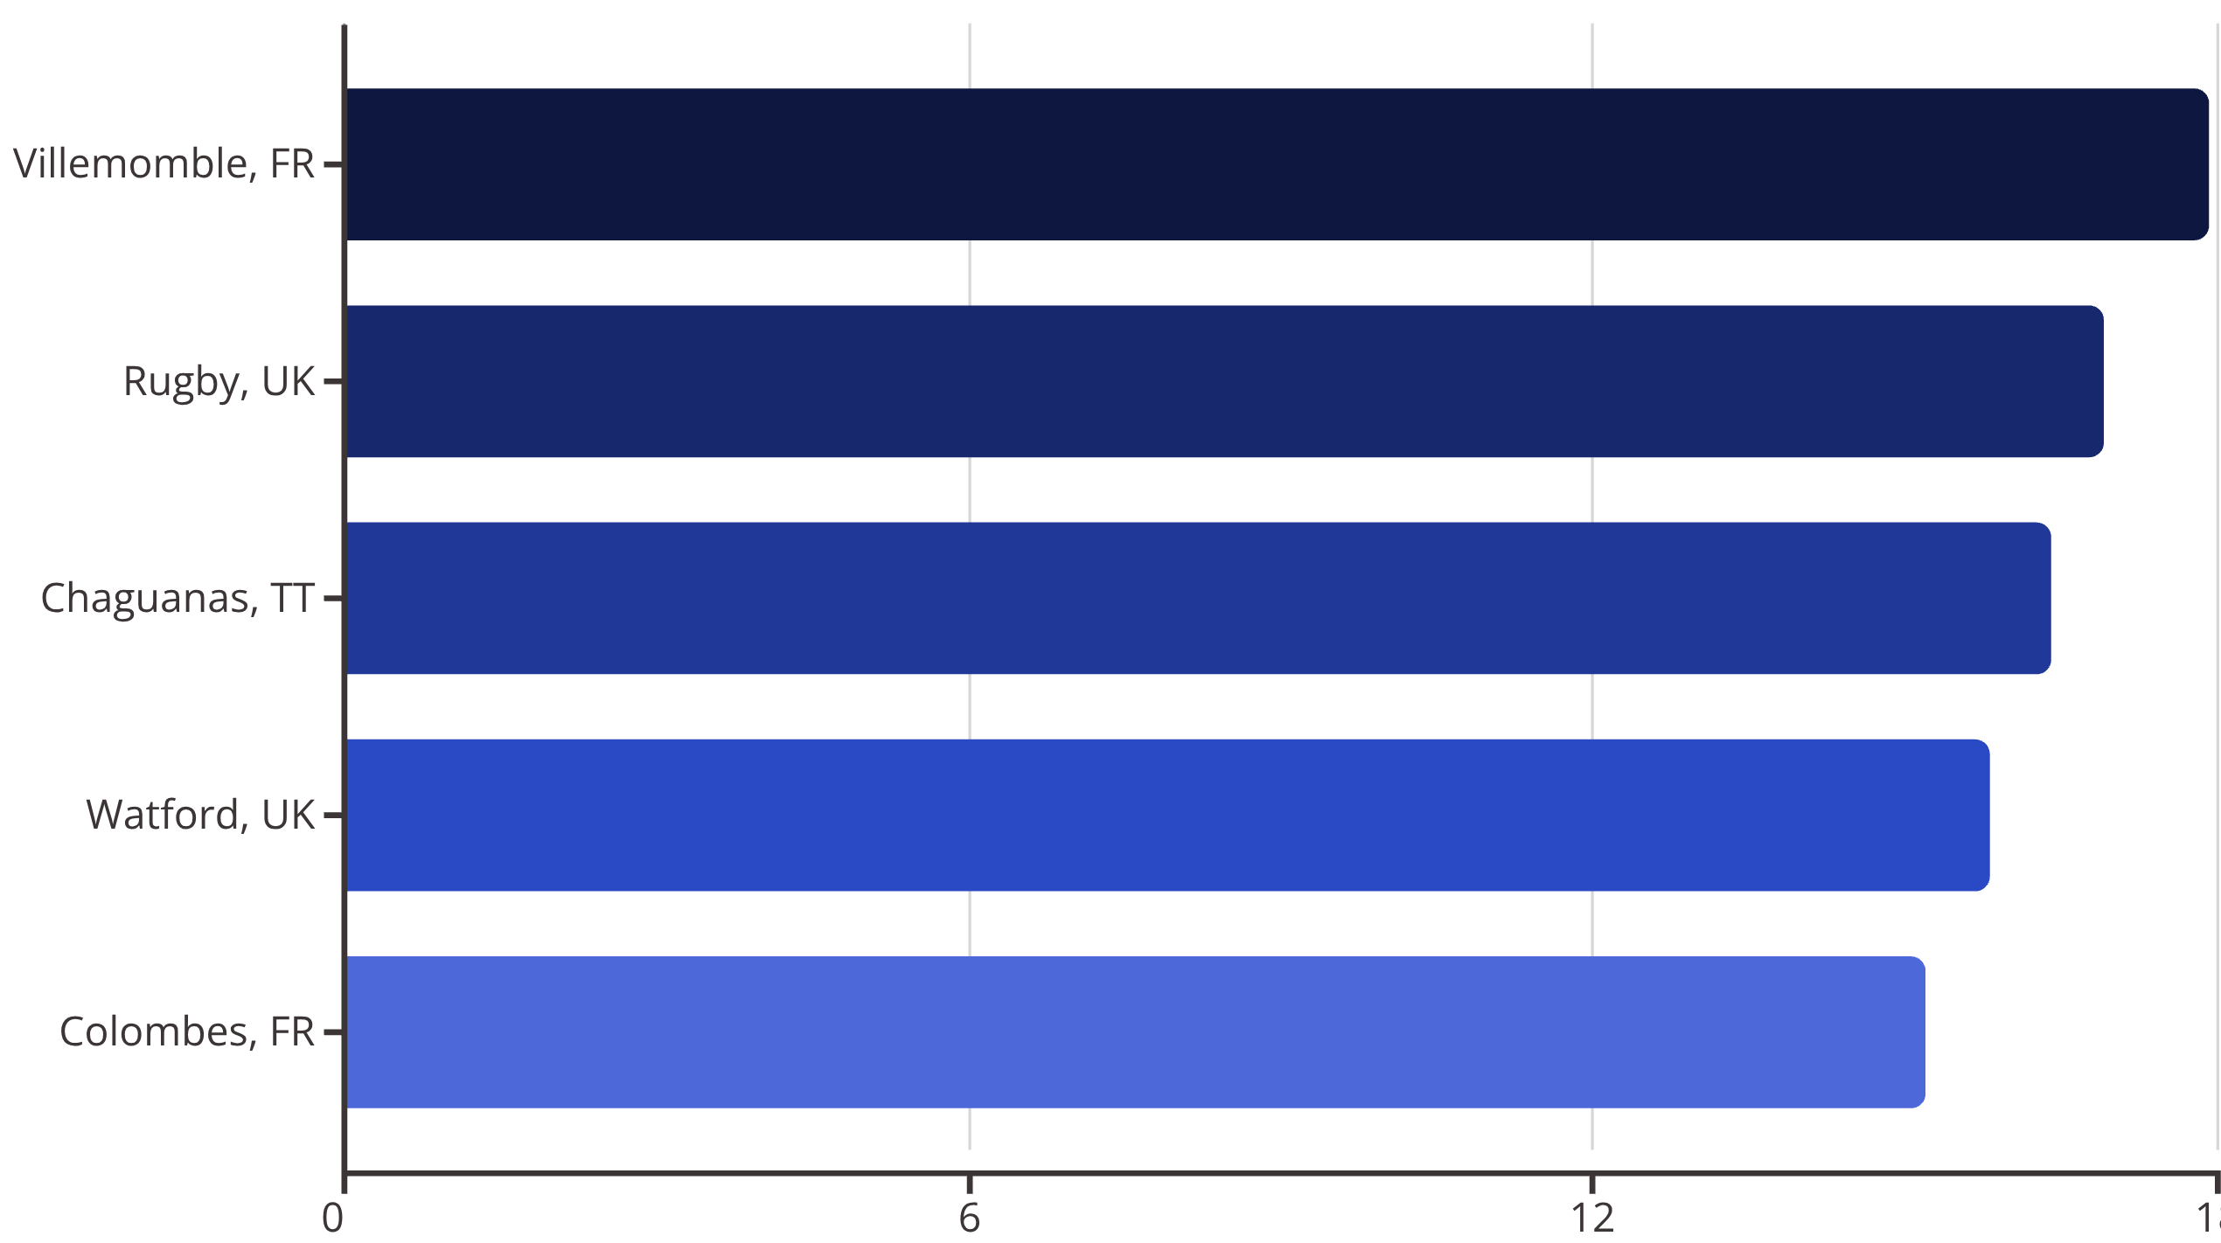
Fraud Risk Geography: High-Alert Locations
Geographic analysis of suspected fraud patterns (minimum 50 orders threshold) identifies specific cities with disproportionately high fraud rates, requiring enhanced verification protocols and payment security measures.
France and UK locations dominate fraud risk zones. Implement enhanced identity verification, address validation, and payment authentication for orders originating from these high-risk geographies.

Slide 13

TEMPORAL ANALYSIS
Critical Alert: Revenue Decline in Late 2017
Time-series analysis reveals a severe downturn in business performance during Q4 2017 and continuing into early 2018. This represents a critical inflection point requiring immediate investigation and remediation.
November 2017
-41.6% MoM Sales Growth
Precipitous month-over-month sales collapse indicating systemic operational or market disruption.
January 2018
-34.2% MoM | -70.5% YoY Profit
Continued deterioration with devastating year-over-year profit decline suggesting structural business challenges.
Root cause analysis required to identify whether decline stems from operational failures, market conditions, competitive pressure, or internal strategic missteps. Recovery plan development is urgent priority.

Slide 14

Seasonality Patterns: Pre-Holiday Surge
October Peak Performance
Monthly sales analysis identifies October as the strongest revenue period with an average order value of $244.79, representing a significant 22% premium over the annual baseline of approximately $200.
$244.79
+22%
October AOV
Above Baseline
Peak month performance
Premium vs. annual average
Strategic Implications
This pre-holiday surge pattern suggests strong opportunity for targeted October marketing campaigns, inventory optimization, and promotional strategies to maximize this naturally high-performing period. Capacity planning should account for this predictable seasonal lift.

Slide 15
CONCLUSION
Key Takeaways and Strategic Recommendations
The implemented data architecture demonstrates professional-grade workflow capabilities, successfully transforming raw legacy data into actionable intelligence across multiple business dimensions.
Pipeline Excellence
Critical Bottlenecks Identified
Python ETL workflow ensures clean, consistent, privacy-compliant data entry with sophisticated feature engineering creating analytical-ready datasets for downstream SQL analysis.
France logistics infrastructure presents severe operational risks with extreme delay variance. First Class shipping reliability at 95.3% late rate requires immediate carrier intervention and SLA renegotiation.
Financial Risk Areas
Revenue Crisis Alert
Strength Training category operates as loss leader with 0.60% margin. Book Shop and Pet Shop departments critically underperform. Strategic review needed for category rationalization or optimization.
Q4 2017 downturn with -70.5% YoY profit decline in January 2018 represents existential threat requiring urgent root cause analysis and comprehensive recovery strategy development.

